Slide 1




Omada for the Better Health Collective
Programs Overview
Notes:
Welcome

Slide 2
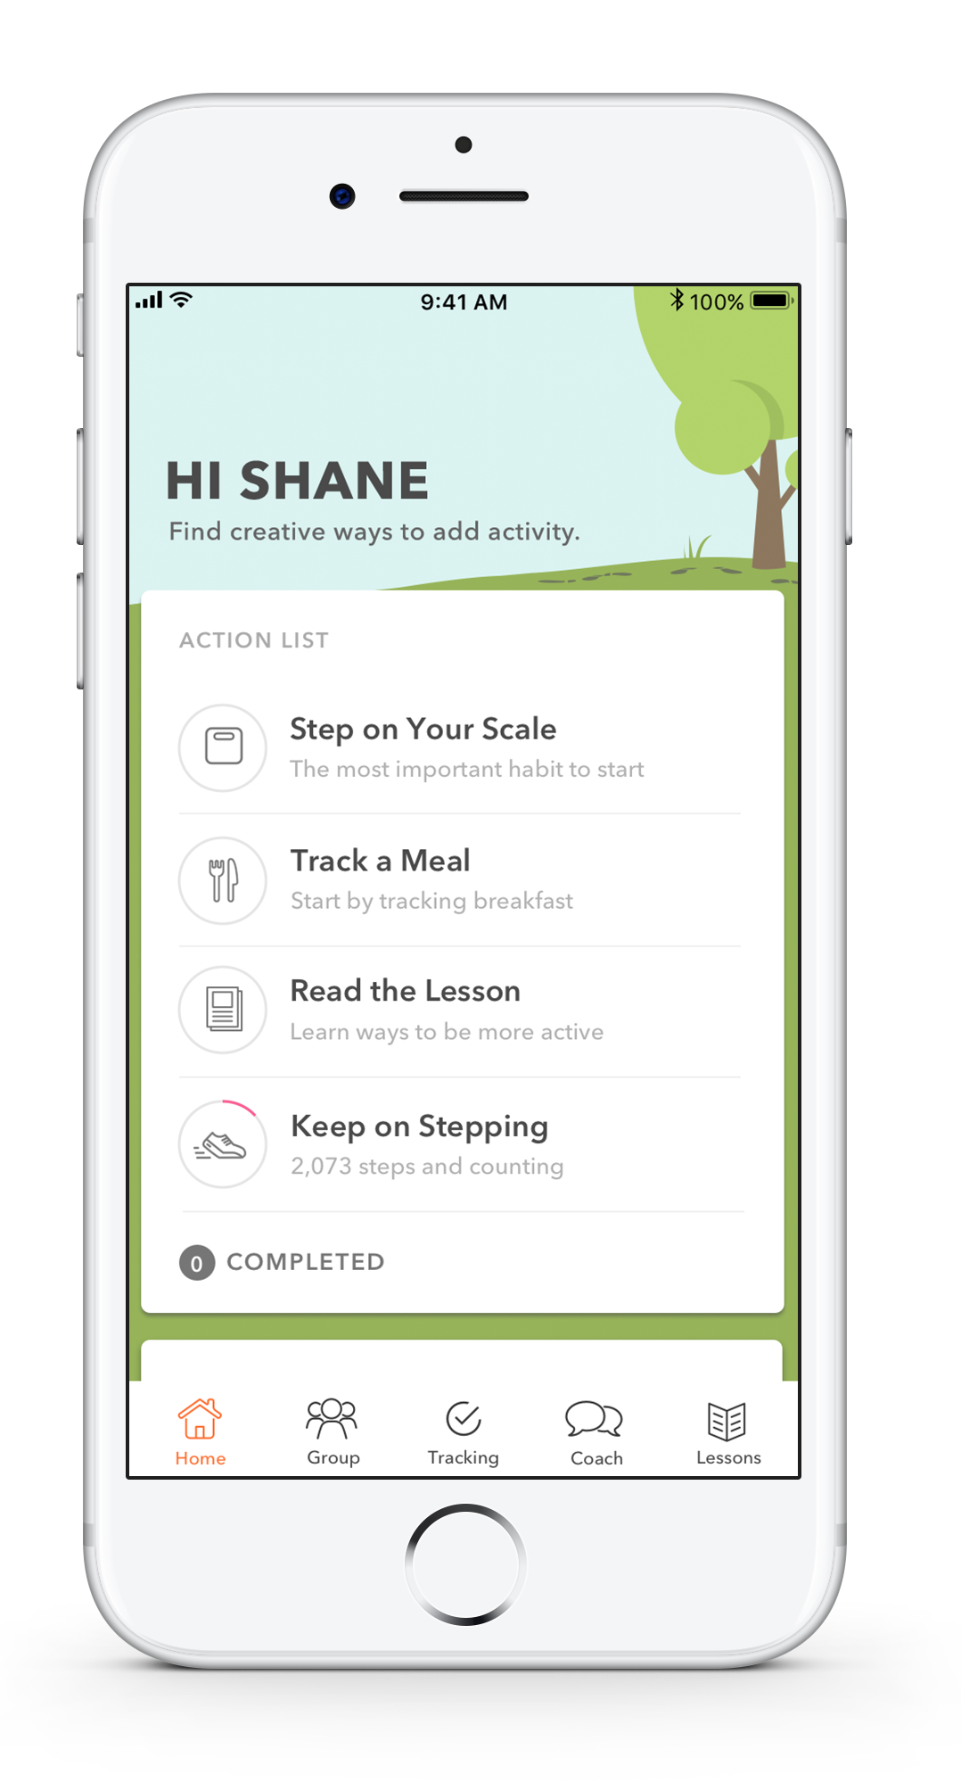

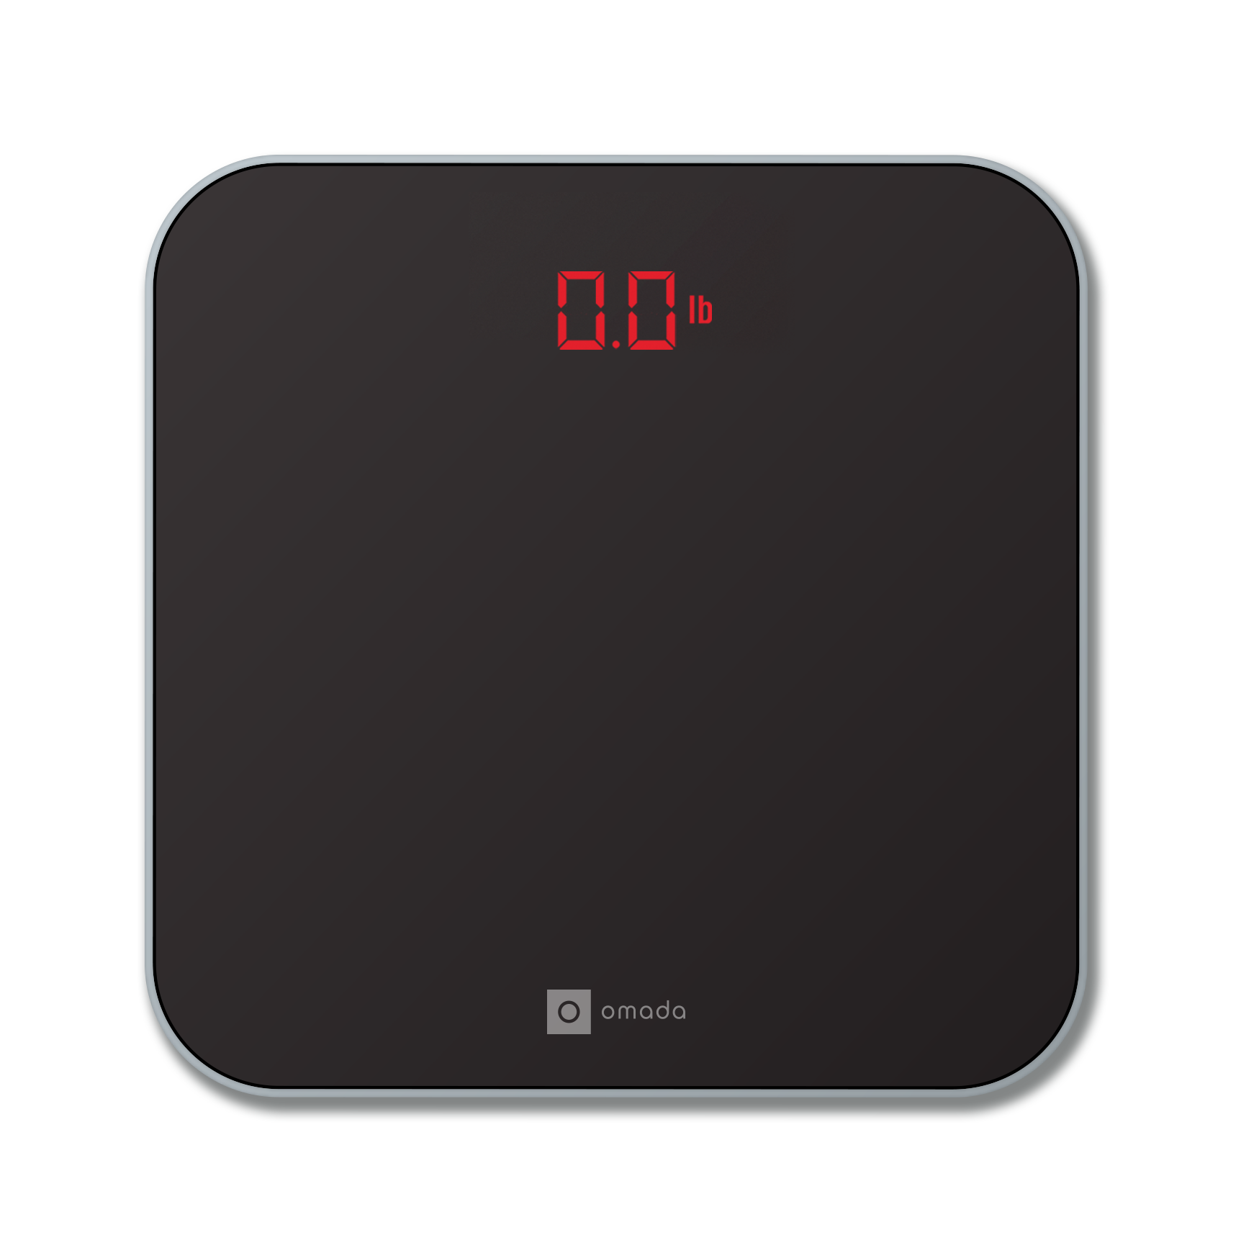



Omada for Prevention
Improve Overall Health
—
Program Goals
Program Features
Health coach
Real-time interventions
Peer Groups
DPP certified curriculum
Connected scale, food and activity tracking
Sustainable weight loss
Reduce the risk of developing T2D, heart disease and stroke

Slide 3
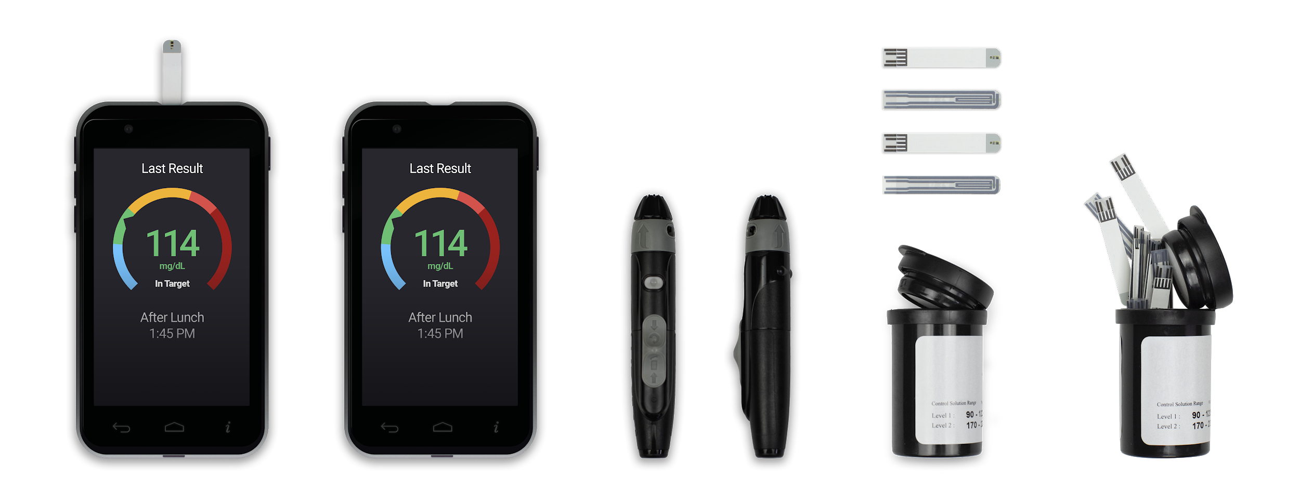

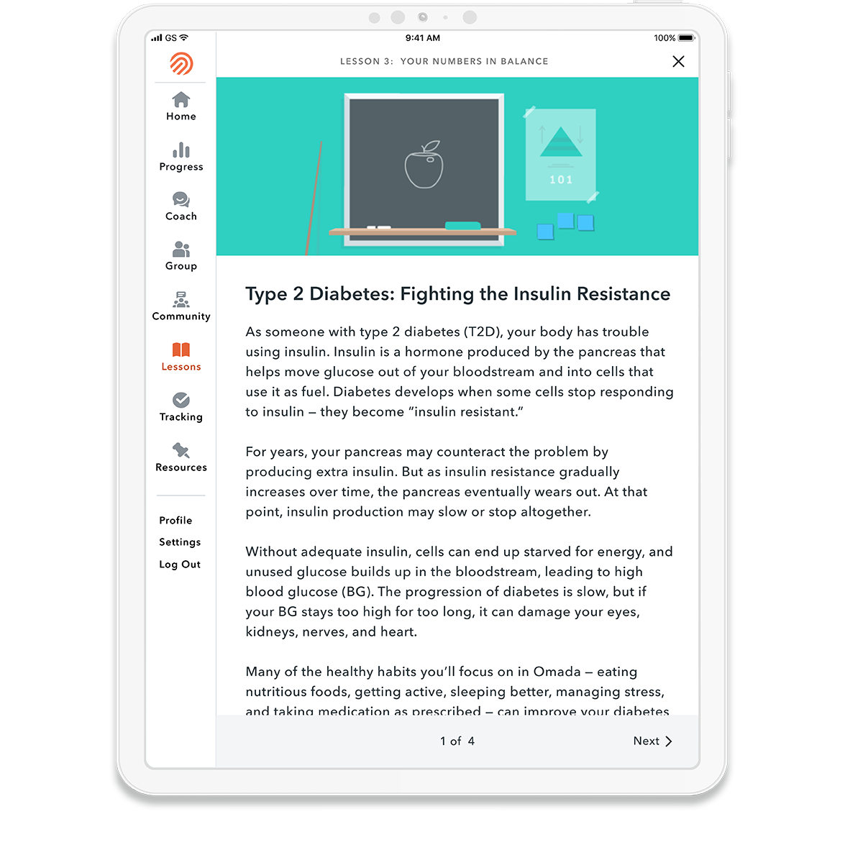




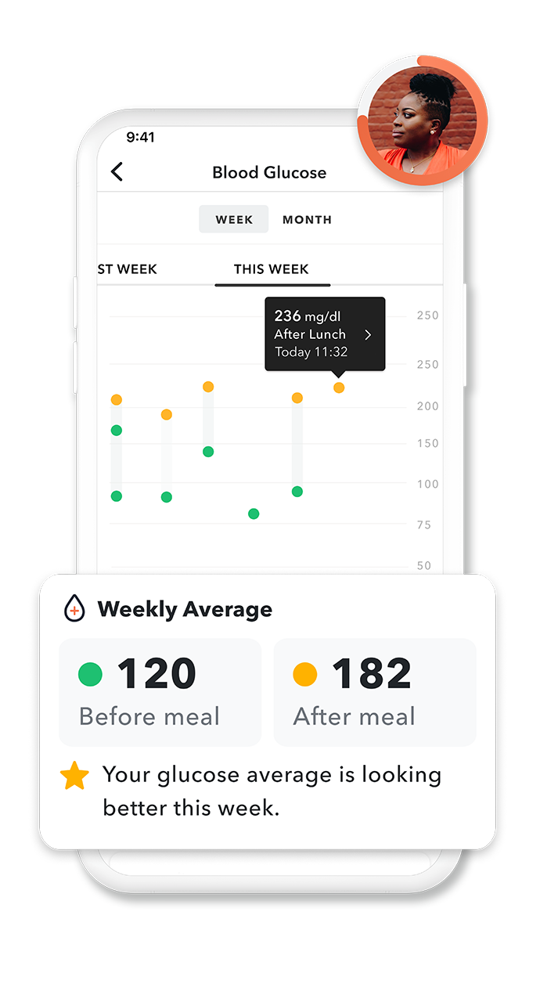
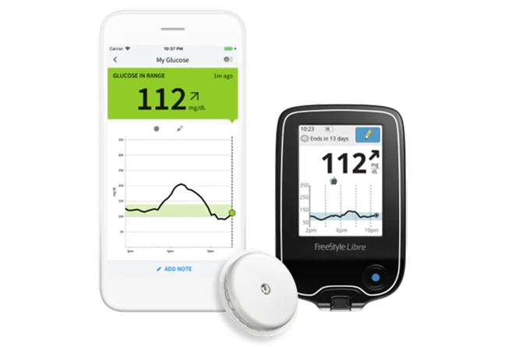
Omada for Diabetes
Improve Blood Glucose Control
—
Program Goals
Program Features
Certified Diabetes Educator (CDCES)
Real-time interventions
T1 & T2 Specific Peer Groups
Continuous Glucose Monitor
Blood Glucose Meter w/automatic refilled test strips & lancets
Additional Devices as needed (scale & BP Cuff)
Achieve and maintain target blood glucose levels
Reduce the risk of complications and diabetes distress
Build confidence to self-manage medications

Slide 4
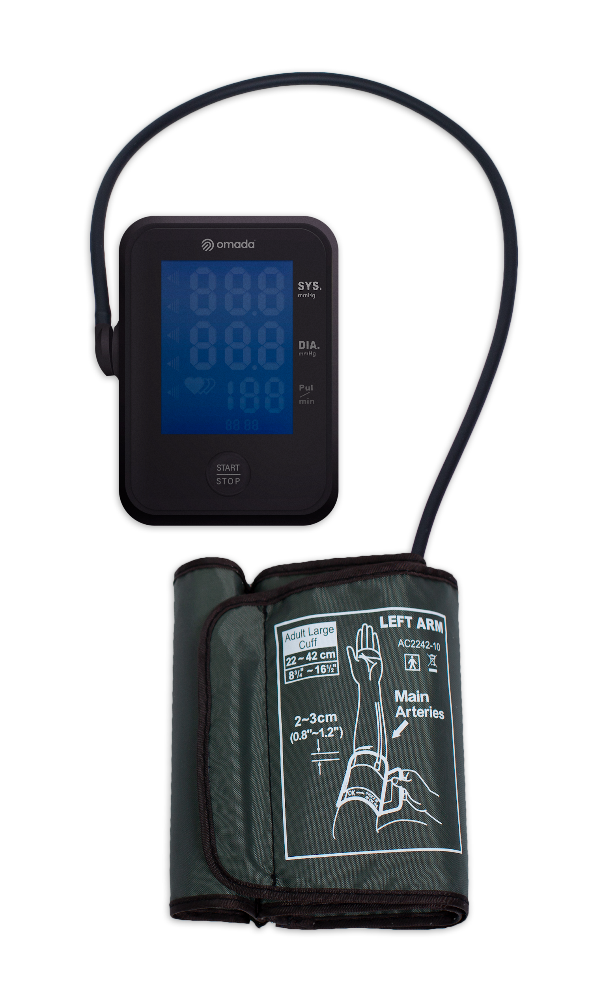


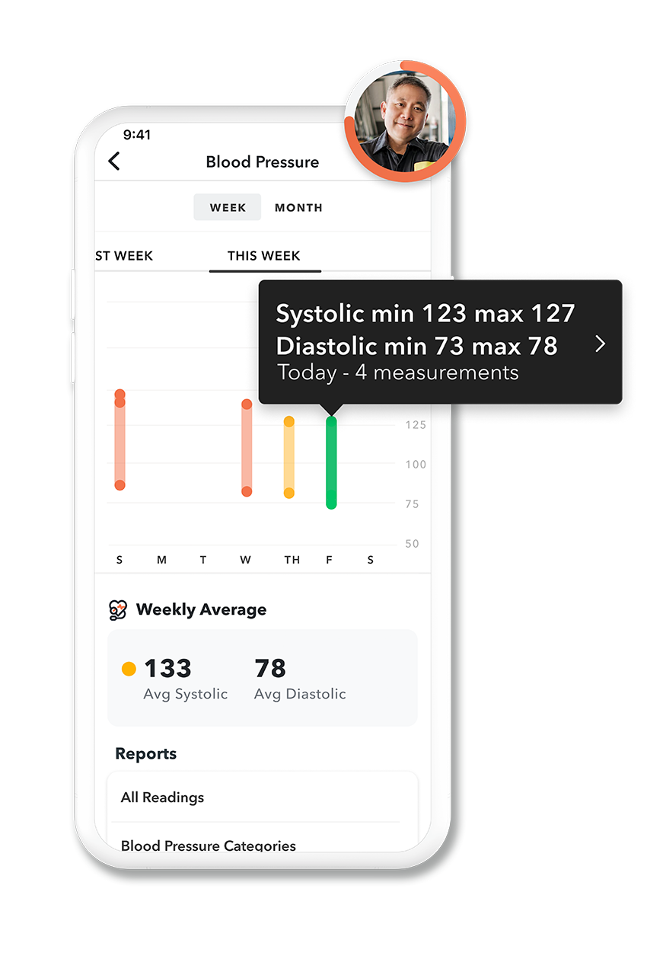
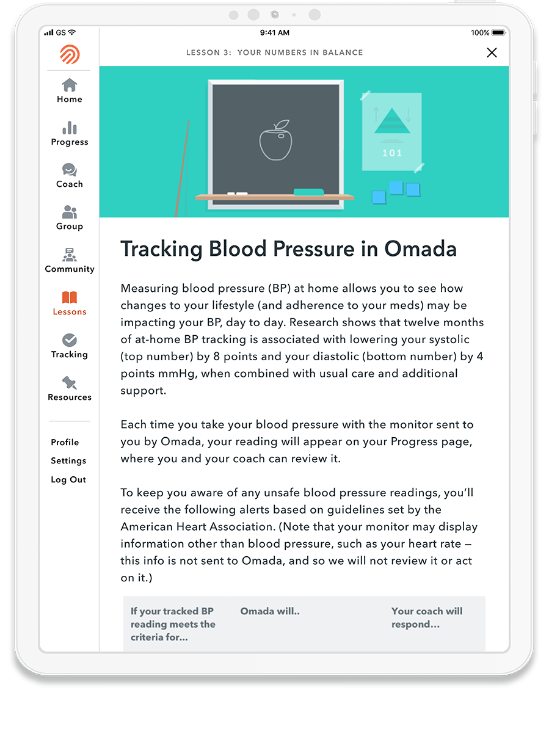
Omada for Hypertension
Improve Blood Pressure Control
—
Program Goals
Program Features
Health coach & HTN Specialist
HTN curriculum
Real-time meaningful interventions
Peer Group & Topic-based communities
Connected Devices
Achieve target
blood pressure
Reduce cardiovascular risks

Slide 5



Omada for Diabetes & Hypertension
Improve Blood Glucose and Blood Pressure Control
—
Program Goals
Program Features
Health Coach, Certified Diabetes Educator & HTN Specialist
Diabetes + HTN specific curriculum
Real-time interventions
Peer Group & Topic-based communities
Connected Devices
Achieve & maintain target blood pressure and glucose levels
Reduce the risk of complications and diabetes + HTN distress
Learn to self -manage medications

Slide 6
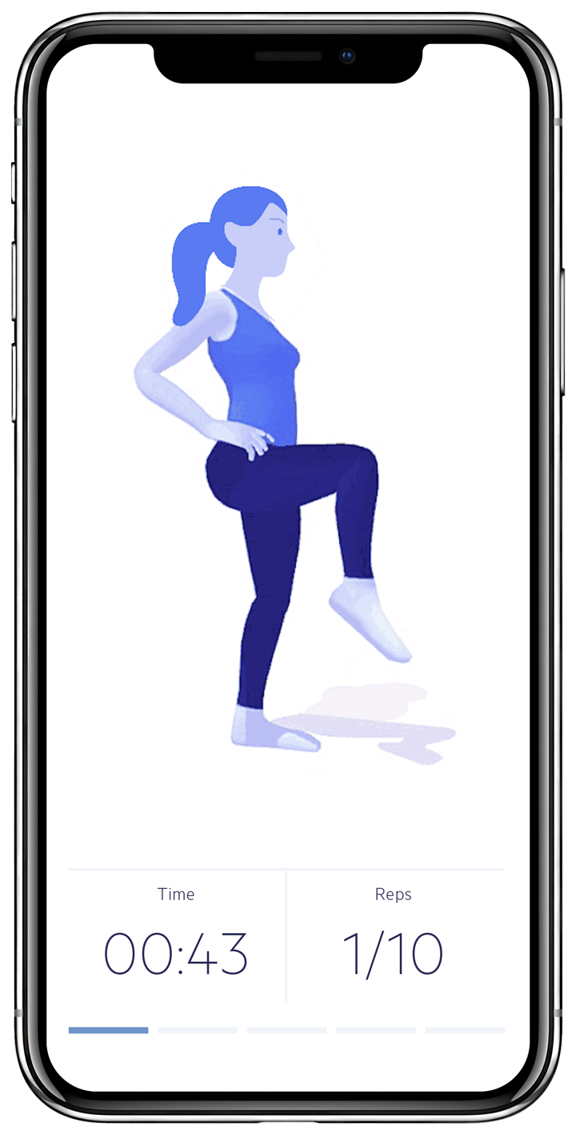

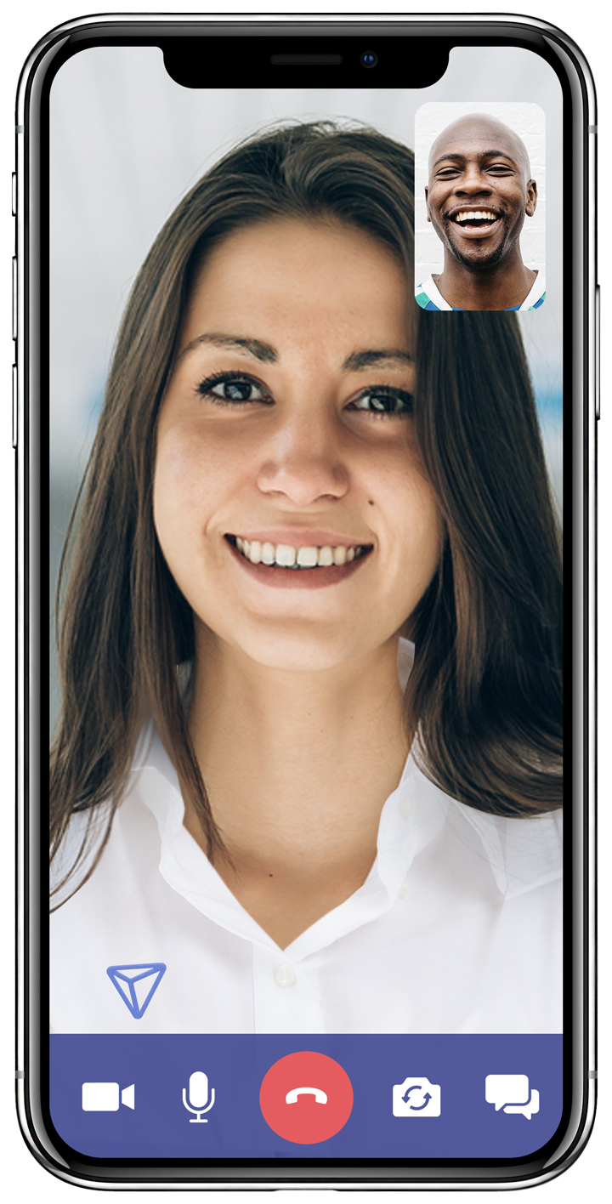
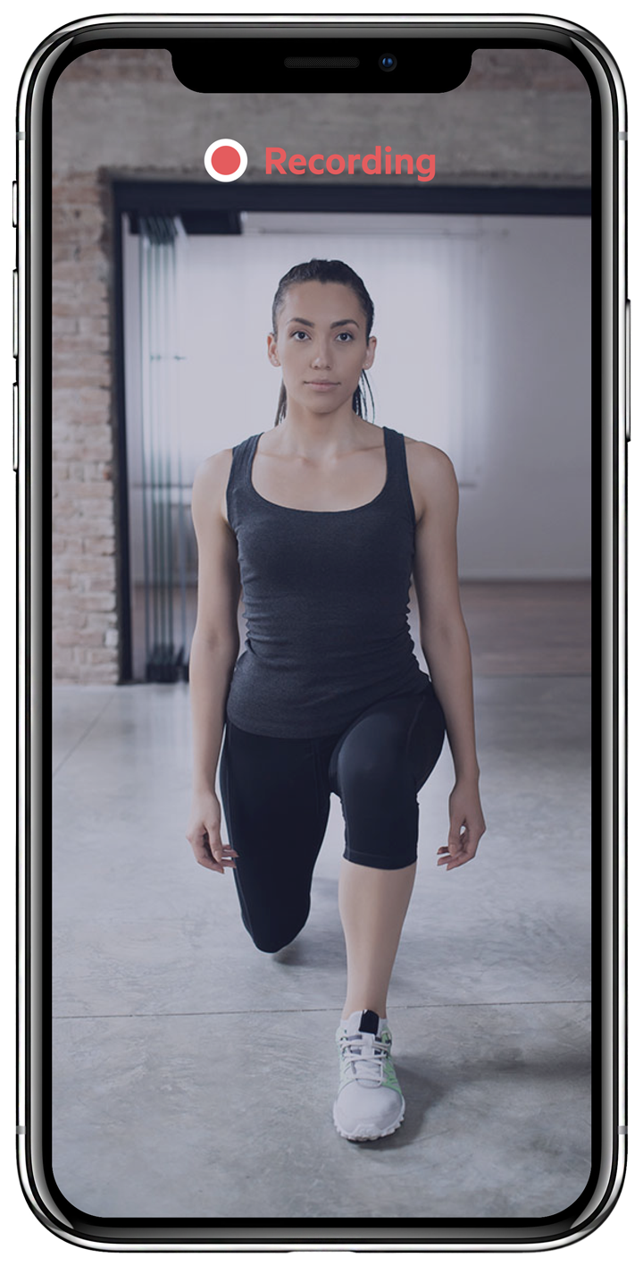
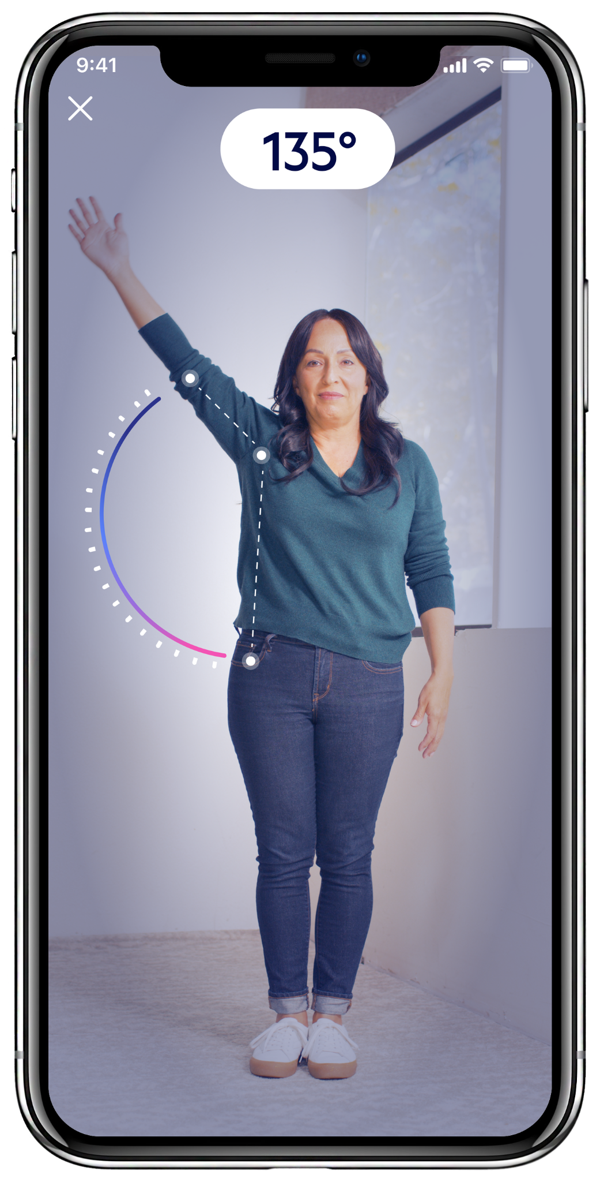
Omada for Muscle and Joint Health
Improve Overall Muscular and Joint Care
—
End-to-end, evidence- based care
Program Features
Prevention: Education, Mobility assessment, Posture guidance, Supportive exercise
Consultation: Red flag screening, Diagnosis, Individualized Care Plan
Recovery Program: Individualized Plan, Unlimited PT support, Outcomes tracking, 3D guided exercises, Computer Vision
Care delivered by world-class PTs with cutting-edge technology. The result is a solution that supports members throughout their journey – with guidance, treatment, and care from real, licensed PTs.

Slide 7


Slide 8
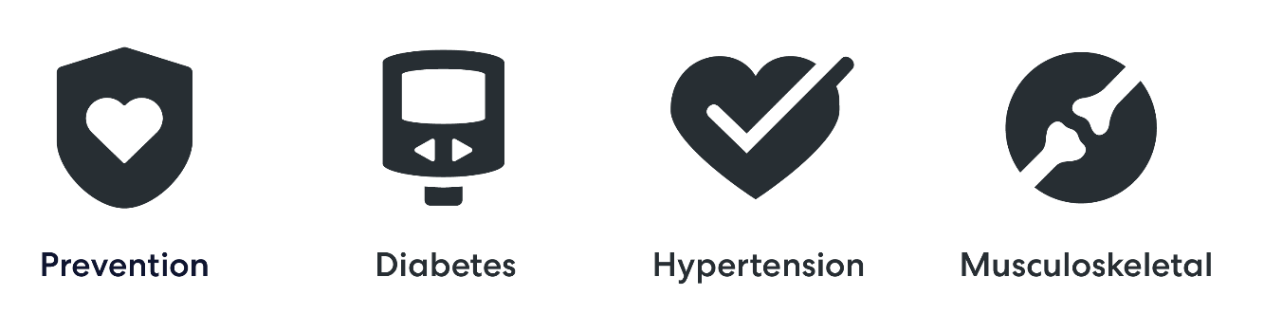
omadahealth.com/sourcewell

