Slide 1



Progyny Fertility and Family Building
Progyny partners with the Better Health Collective to provide an inclusive family building benefit. Progyny’s mission is to provide a healthy, timely, and supported family building journey.
Comprehensive Coverage
Fertility treatment coverage and family building services for every unique path to parenthood.
Personalized Support
Unlimited clinical and emotional support from a dedicated Patient Care Advocate (PCA).
High Quality Care
Convenient access to a network of top fertility specialists across the US.
To learn more and activate your benefit, call: 833.208.8447

Slide 2
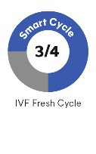
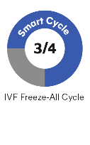
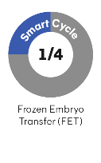
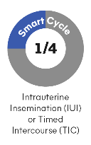
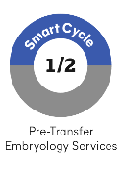


Your Fertility and Family Building Benefit
Your Progyny benefit was specifically designed to give you the best chance of fulfilling your dreams of family. Whether you just want to learn more about your options, are trying to conceive, or exploring fertility treatment, Progyny is here to support you each step of the way. The Progyny Smart Cycle covers all the individual services, tests, and treatments you may need.
Your Progyny coverage includes:
1 Smart Cycle*
Progyny Rx Integrated fertility medication coverage
Fertility Preservation Egg and sperm freezing coverage**
Donor Tissue Purchase Egg and sperm tissue purchase coverage
Note: The person(s) receiving fertility treatment must be enrolled in an eligible medical plan through Better Health Collective | Sourcewell to have access to the Progyny benefit. You are subject to financial responsibility according to your plan. Please consult with your human resources department to confirm your eligibility.
*You have access to an additional Smart Cycle if your first is not successful
**When medically necessary
Common ways to use a Smart Cycle:

Slide 3

Notes:
SUCCESS STORY: One couple facing infertility uses their health plan benefit, Progyny, to successfully grow their family.

