Slide 1
Open
Enrollment
2024 Benefits
Add Name of Group

Slide 2
Today, you’ll…
Get an overview of your plan options
Review added benefits through Sourcewell Pool
Learn how HealthPartners supports you
Know what happens next

Slide 3
Summary of changes effective in 2024
Hearing Aids
Per MN mandate, health plans can no longer place age or dollar limits on hearing aids. Hearing aids will be covered one per ear every three years for all ages
Smart Plans:
Increases to deductible/out of pocket on all Smart Plans per IRS index
3 free visits with Virtuwell, per member per year, covered at 100% from 1/1/2023-12/31/2024.

Slide 4

Open Access network
Get the most choices of doctors and clinics.
You’re here
healthpartners.com/openaccess

Slide 5
Insert Plan options for member
Replace with your entity's 2024 plans
 | $300 Deductible Plan | Smart Plan 1- $1,500-100% HSA | Smart Plan 3- $3,000-100% HSA | Smart Plan 5- $3,850-100% HSA
Deductible | $300 Single $900 Family | $1,500 Single $3,000 Family | $3,000 Single $6,000 Family | $3,850 Single $7,700 Family
Out-of-pocket maximum | $1,200 Single $2,400 Family | $1,500 Single $3,000 Family | $3,000 Single $6,000 Family | $3,850 Single $7,700 Family
Preventive care | 100% Coverage
Notes:
Replace with your entity's 2024 plans: contact your broker or leah.boedigheimer@sourcewell-mn.gov for the most up-to-date info for your group

Slide 6
Plan options cont. Example
Replace with your entity's 2024 plans:
 | $300 Deductible Plan | Smart Plan 1- $1,500-100 HSA | Smart Plan 3- $3,000-100% HSA | Smart Plan 5- $3,850-100% HSA
Office visit | 80% after Deductible | 100% after Deductible | 100% after Deductible | 100% after Deductible
Convenience care | 80% after Deductible | 100% after Deductible | 100% after Deductible | 100% after Deductible
Outpatient Hospital | 80% after Deductible | 100% after Deductible | 100% after Deductible | 100% after Deductible
Inpatient Hospital | 80% after Deductible | 100% after Deductible | 100% after Deductible | 100% after Deductible
Emergency Care | 80% after Deductible | 100% after Deductible | 100% after Deductible | 100% after Deductible
Durable Medical Equipment | 80% after Deductible | 100% after Deductible | 100% after Deductible | 100% after Deductible
Notes:
Replace with your entity's 2024 plans: contact your broker or leah.boedigheimer@sourcewell-mn.gov for the most up-to-date info for your group

Slide 7
Pharmacy Benefits Example
Replace with your entity's 2024 plans
 | $300 Deductible Plan | Smart Plan 1- $1,500-100 HSA | Smart Plan 3- $3,000-100% HSA | Smart Plan 5- $3,850-100% HSA
Generic formulary | $15 copay | 100% after deductible | 100% after deductible | 100% after deductible
Brand formulary | $15 copay | 100% after deductible | 100% after deductible | 100% after deductible
Non-formulary | $30 copay | No coverage | No coverage | No coverage
Preventive generic | NA | $0 copay | $0 copay | $0 copay
Preventive brand | NA | $50 copay | $50 copay | $50 copay
Notes:
Replace with your entity's 2024 plans: contact your broker or leah.boedigheimer@sourcewell-mn.gov for the most up-to-date info for your group

Slide 8
Prescription coverage
Check your formulary to understand your costs and get support if your medicine isn’t working for you.
P
Covered
On formulary
Not covered on your plans
Preventive
healthpartners.com/pharmacy

Slide 9

Medicine delivered to your door
Skip the trip to the pharmacy. Get your prescriptions mailed to your home.
Five great things about mail order:
You’ll never pay for standard shipping.
Refilling your medicine online or with our mobile app is easy.
All orders are sent in a tamper resistant, plain package to make it more private.
Safety is important to us. You’ll get the best quality medicine.
You'll get your medicine delivered within seven to ten days.
healthpartners.com/mailorder

Slide 10
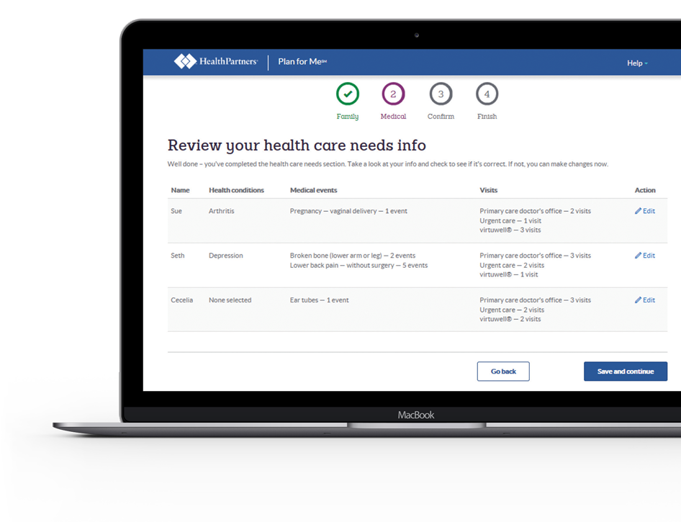

Find the best plan with Plan for MeSM
Compare your plan options and potential costs – all based on your unique situation.
Enter the age and gender for you and anyone else you want your plan to cover. Pick from a list of common health conditions, medical events, care visits and medicines.
Check if your doctor is in-network
See how your meds are covered
Estimate your health care costs
Compare your plan options
Get started at healthpartners.com/planforme
Group #5139 NOTE: replace with # found on front of your card
Site: All
Effective date: 01/01/2024

Slide 11
Additional Benefits
NOTE: Add your group’s info here
Notes:
Add your group’s info about dental, vision, etc., here

Slide 12

What is the ‘Top care, top value’ program?
You don’t have to sacrifice top care for top value
Facing surgery or a medical procedure?
Top Value plans help you locate the
best provider at the best value
You’ll receive reimbursements for travel
and accommodations to and from the
Top Value provider
Gift card reward if receiving eligible procedure at top value facility
End result: you get the best care and you pay less
Top value incentives and rewards only available on Open Access Smart Plans

Slide 13
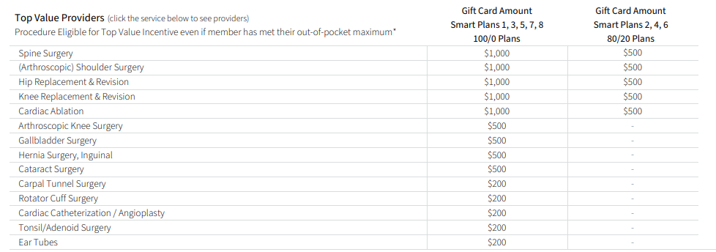
Top Value Reward Card Program

Slide 14


Omada
Includes Omada Diabetes Prevention and Omada Condition Management
Health Coaching
Tools/Resources
Online Questionnaire
“The best part of the program to me it that is encourages small, lasting changes versus changing everything all at once and making success more difficult. “
Participant feedback

Slide 15
Find balance with everyday support
Your Employee Assistance Program (EAP) has your back 24/7. It's free and completely confidential.
Adopting
a child
Finding
child care
Grieving
Knowing your
legal options
Making
a budget
Managing
stress
hpeap.com | 866-326-7194 | iConnectYou mobile app | hpeap.com password: sourcewell

Slide 16

Personal nurse support
Help from a personal nurse.
Healthy
Pregnancy
Cancer
Management
Low Back Pain
Focus on your goals
Getting the right care
Work with you and your doctor
Connect you
to resources
Answer
questions
healthpartners.com/nursesupport

Slide 17
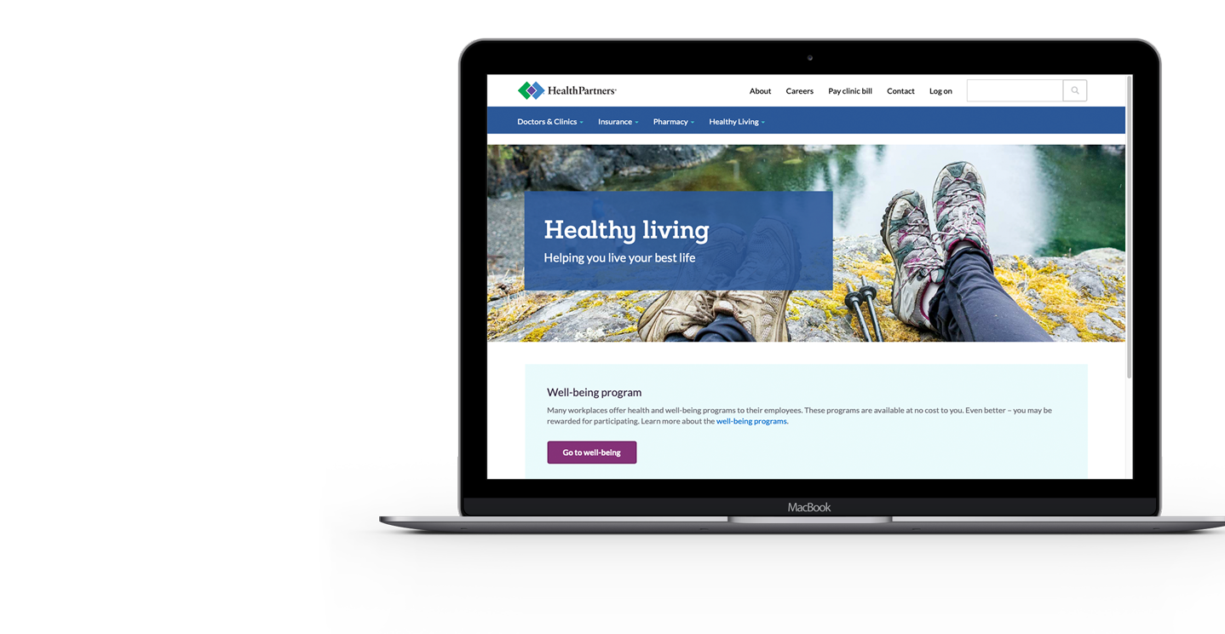
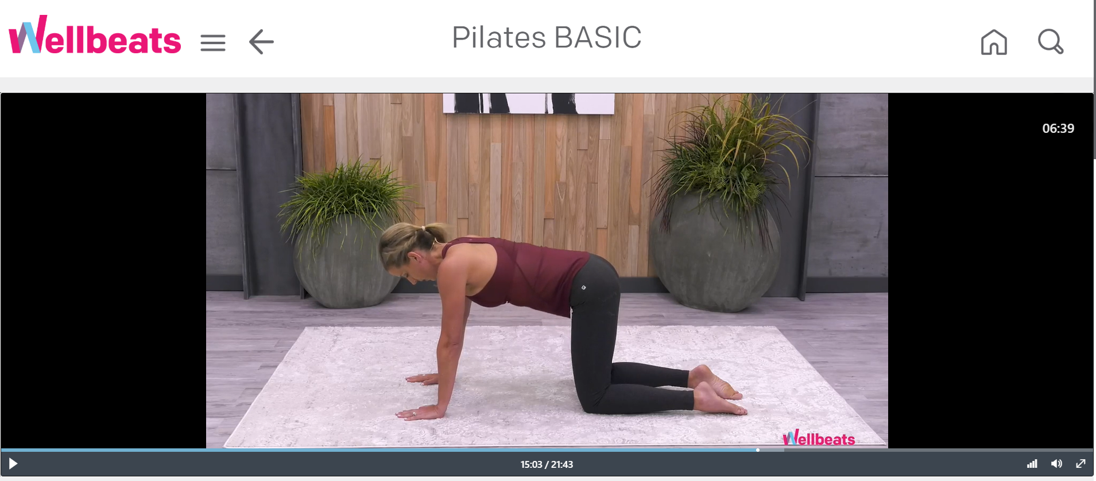
Move more with Wellbeats
Wellbeats has on-demand workouts and challenges, along with a team of friendly, certified virtual trainers who are ready to help you reach your goals.
Enjoy classes like yoga, running, HIIT, strength training, recovery, meditation, and more
Personalized recommendations based on your
preferences and goals
healthpartners.com/livingwell

Slide 18
MyStrength
Free, Digital resource to help build resilience, reduce stress and lower anxiety.
Support on emotional health and life topics:
Controlling Anxiety
Improving Sleep
Relieve stress
Drug and Alcohol Recovery
Pregnancy & Early Parenting
Adjust to life without tobacco and vape
Relationships
Caregiving
healthpartners.com/mystrength

Slide 19

Healthy Discounts – Featured Program
Notes:
Active&Fit Direct is a third-party provider of a fitness membership program that gives you access to nearly 12,000 fitness centers and studios nationwide. Members pay a monthly fee – plus an initial enrollment fee. Watch this quick video to learn how to enroll.

Slide 20

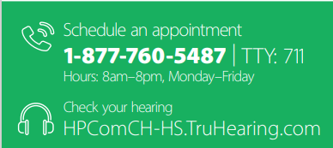
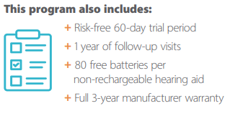
Offers:
  a free online hearing assessment
  access to a hearing exam
  substantial discounts on hearing aids, fittings and follow up care
Notes:
=

Slide 21

Offers:
  Comprehensive weight management program
    Creates personalized weight loss plan with 1 on 1 health coaching
  HealthPartners has partnered with Profile to offer all members:
    $100 off on a Profile membership PLUS
    $49 in Profile Cash to purchase items from the Profile store
Discount available under the Eating Well section in Health Discounts or by going directly to www.profileplan.com/healthpartners-members

Slide 22
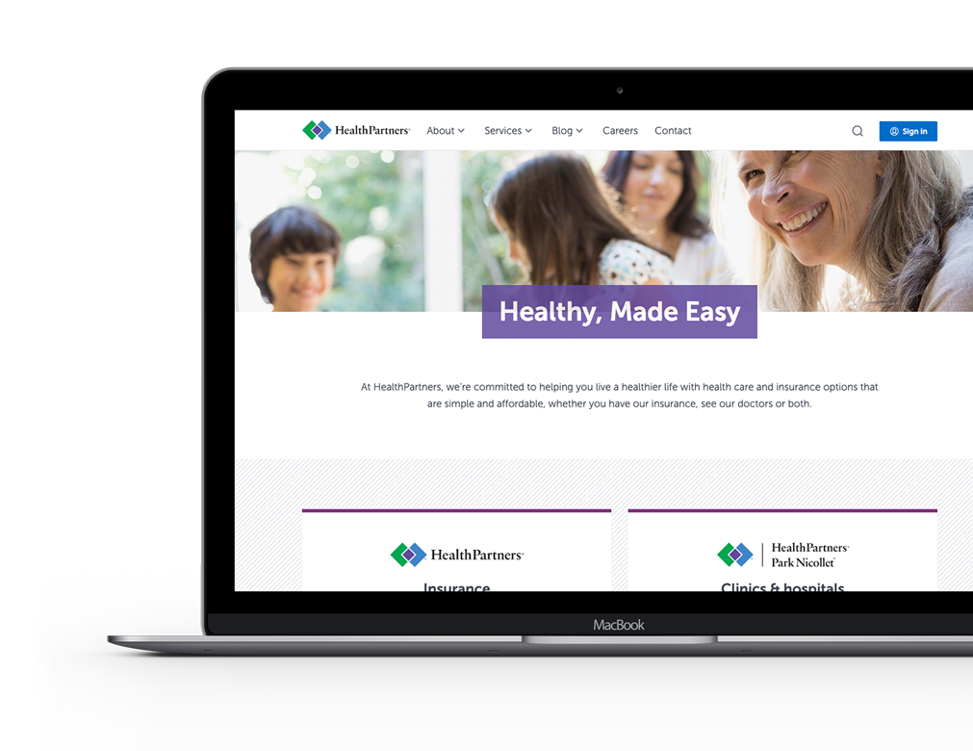
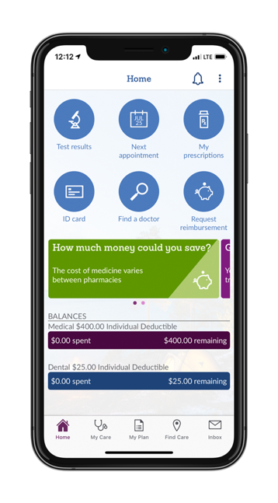
Let’s keep in touch
As your new plan year begins, it’s important to stay connected.
Watch for your
ID card in the mail
Create and use your online account
Get tips and reminders via email
Call us with questions
healthpartners.com/signupnow

Slide 23
We look forward to supporting you…..
Thank You!
healthpartners.com

