Slide 1
Collective [ kuh-lek-tiv ]
adjective
People acting as a group.
Belonging to all the members of a group.
noun
A cooperative enterprise.
Better Health Collective
Notes:
Our entity is a member of the Better Health Collective. What is the Better Health Collective?
In technical terms, the Better Health Collective is an intergovernmental joint self-insurance pool. The Association of Governmental Risk Pools offers an excellent definition: “Pools are groups of public entities that unite to share their risks and insurance costs and improve their own commitment to safety, risk management, loss control, and insurance cost containment.”
What’s the difference between an insurance carrier and the Better Health Collective? Whereas an insurance carrier is a private company that provides insurance coverage to individuals or entities in exchange for premiums, an intergovernmental joint-risk pool is a collective arrangement among public entities to share the risks and costs of insurance claims. The main distinction is ownership: private vs. public collaboration.
It’s public sector groups…working together to provide group health insurance and other programming to manage risk and contain costs.
----------------
Citation: Association of Governmental Risk Pools, “PR Toolkit for Public Entity Pools,” 2014.

Slide 2

Better Health Collective members
Counties
& other government
Cities
School districts
Baxter
Becker
Birchwood Village
Brainerd
Elk River
Farmington
Forest Lake
Granite Falls
Little Falls
Mounds View
New Brighton
New Prague
Pequot Lakes
Savage
West Saint Paul
Wyoming
Dassel-Cokato
Freshwater Education District
Long Prairie-Grey Eagle
McGregor
Melrose
Menahga
Mid-State Education District
Pierz
Princeton
St. Anthony – New Brighton
Swanville
Verndale
Waubun-Ogema-White Earth
Austin Public Utilities
League of Minnesota Cities
Sourcewell
Todd County
List current as of Sept. 1, 2023
Notes:
We’re one of 32 public entity member groups across Minnesota; most are cities and school districts, plus one county and a few other government entities.

Slide 3
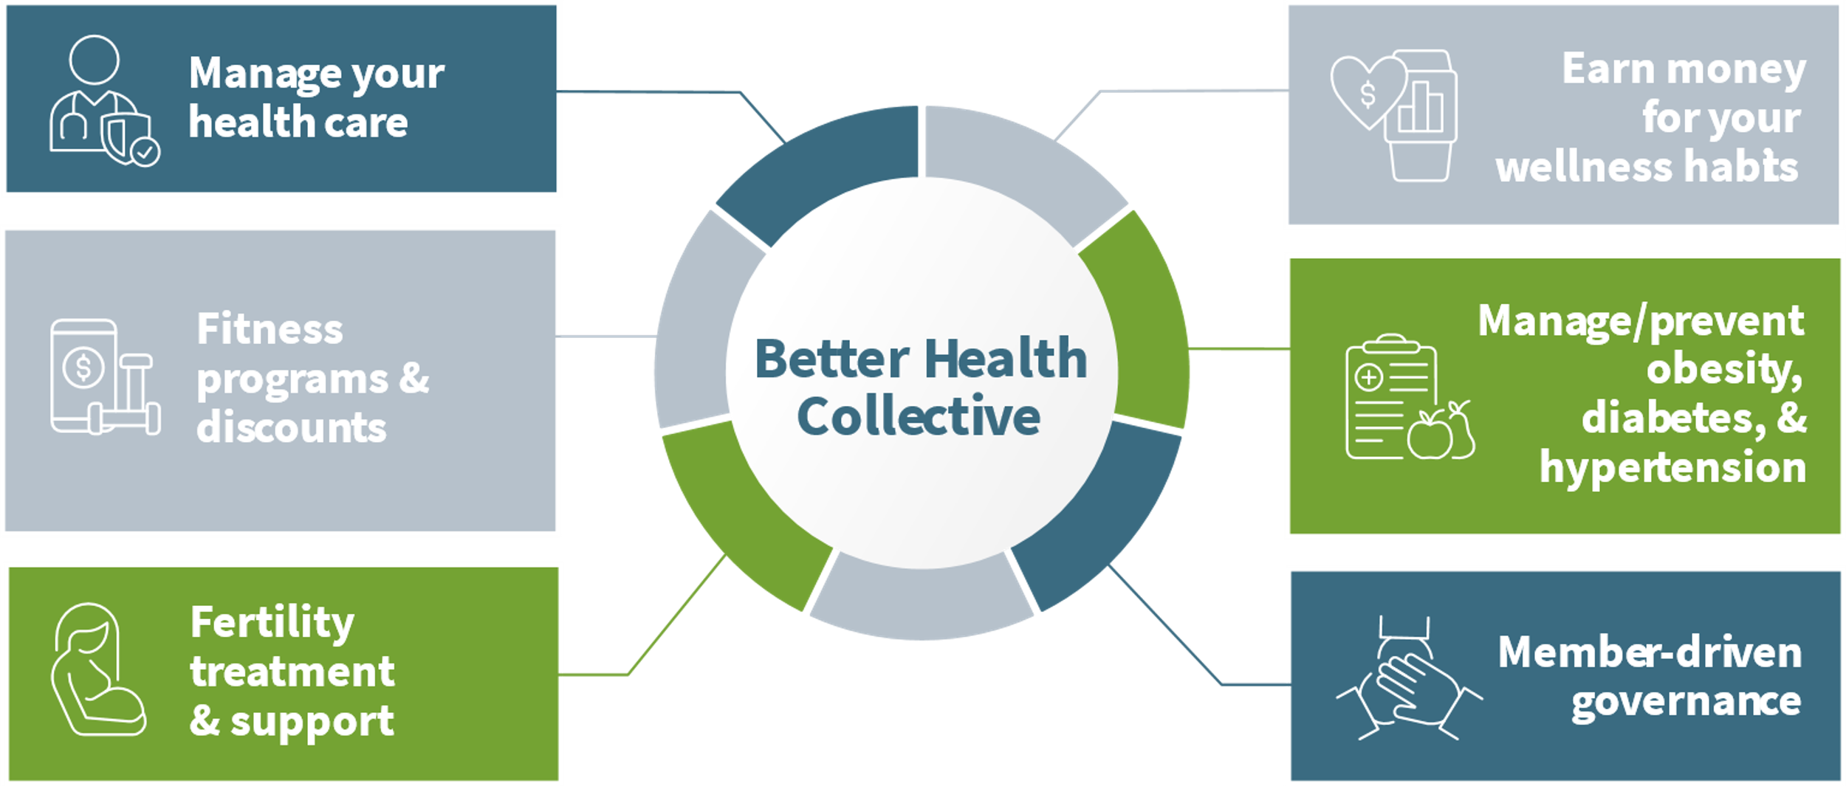
Notes:
Think of our group health insurance as a package deal.
The Better Health Collective brings together all the pieces and partners to help you:
- Manage your health care
- Access Fitness programs & discounts
- Access Fertility treatment & support
- Earn money for your wellness habits
- Manage/prevent obesity, diabetes, & hypertension
-Have voice in the “package!”
HealthPartners helps you manage your health care…they’re the health plan administrator and pharmacy benefit manager for the Collective. They offer our provider network, manage our claims, and offer our Employee Assistance Program (EAP).
You can also access Fitness Programs & Discounts through HealthPartners. You can choose to join Active&Fit Direct (a gym membership network), enroll in Wellbeats (an app-based on-demand workout and wellness platform), build a healthier mind through myStrength® a digital health program… and much more!
The Collective partners with Progyny for Fertility treatment & support for those looking to grow their family.
You can Earn money for your wellness habits using WellRight, an online wellness program offered by HealthSource Solutions. HealthSource Solutions also works with us to plan our wellness activities and programming.
Disease management or disease prevention is another piece of the Collective and is offered through a company called Omada.
The Collective is managed by Sourcewell, a service cooperative headquarted in Staples. But it’s us…the public entity groups... who guide and shape the Collective. There are two key committees: The Labor Management Committee, which advises the Collective’s governing Board of Trustees; and The Wellness Committee, which focuses on evaluating existing and developing future wellness programming as well as grants and incentives.

Slide 4
mn.sourcewell.org/health
Notes:
Find helpful resources and how-to videos on Sourcewell’s website!

Slide 5
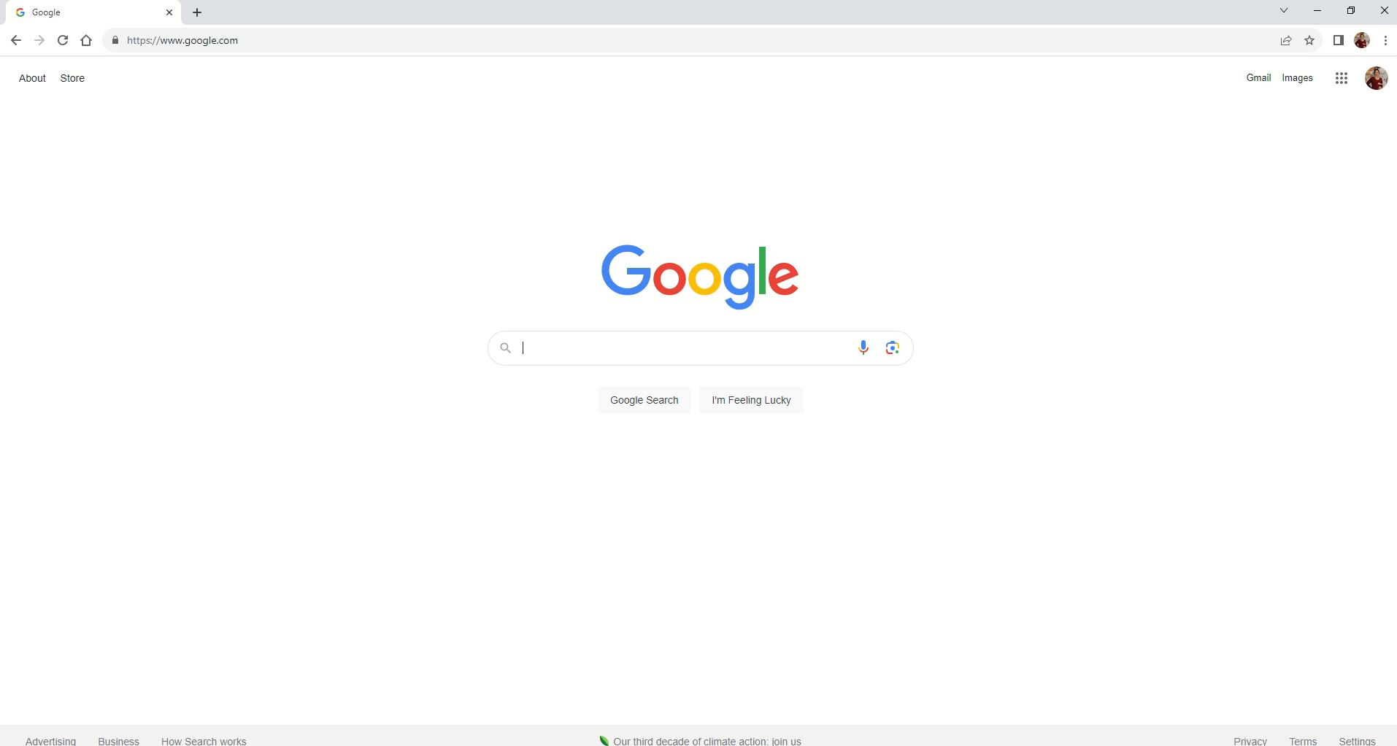
Add screen grab of website from Annual Meeting PPT
Notes:
This video (no sound) will show you how to find the resources and videos.
1. Go to mn.sourcewell.org/health
2. Choose Employees

