Slide 1

Telemedicine services
Notes:
Hello! My name is Amanda Fairbanks and I am he Account Manager that works with the Sourcewell pool at HealthPartners. Today I want to take a couple of minutes to talk about telemedicine services that are available to you as a HealthPartners member. So lets get started!

Slide 2
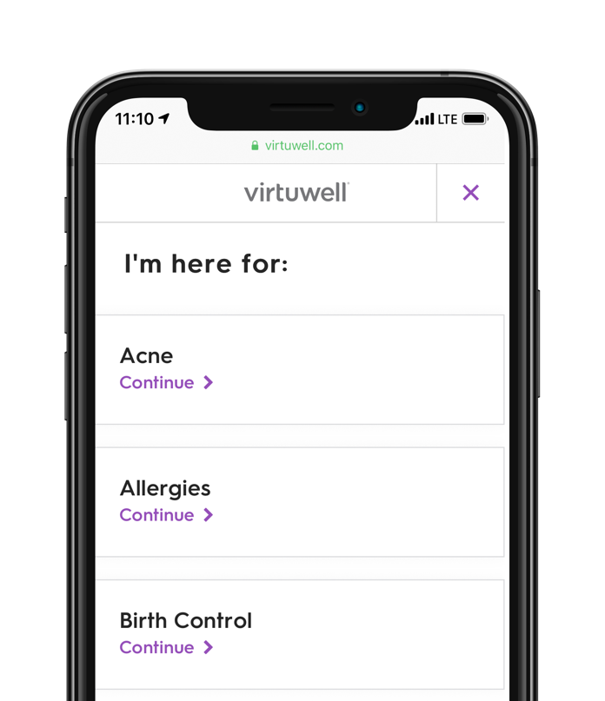
24/7 online care
Save time and money by getting treated right from your smartphone, tablet or computer. Your plan has options.
Easy, fast and guaranteed
Answer a few questions anytime, anywhere.
Treatment plan and prescription in about one hour.
More than 60 common conditions.
You’re only charged if Virtuwell can treat you, plus unlimited follow-up calls are free.
Use your member ID card to check your cost at virtuwell.com/cost/healthpartners.
virtuwell.com
Notes:
Lets talk about virtuwell. Virtuwell is an online clinic that treats more than 60 common conditions. So think of conditions like Pink eye, sinus infection, allergies, and much more. You can Save time and money by getting treated right from your smartphone, tablet or computer. Your plan has more options than just going into the clinic.
So why do I love virtuwell?
Virtuwell® (online questionnaire)
Easy. 99% of Virtuwell users say it's simple and 98% highly recommend it. Answer a few questions at virtuwell.com anytime, anywhere to get a treatment plan for the symptons you are experiencing.
Fast. In about one hour, get a treatment plan and prescription sent directly to the pharmacy of your choosing (if needed). You could save an average of 2.5 hours by using Virtuwell and avoiding in-person visits.
Guaranteed. You’re only charged if Virtuwell can treat you, plus unlimited follow-up calls about your treatment are free. If you need to come in person, we will let you know, but it's not usually needed.
Affordable. Currently, a visit is $54, starting on January 1, 2021 the price of the visit will increase to $59 per visit.
These are just a few main reasons why I love virtuwell. Head to virtuwell.com to check it out today.

Slide 3
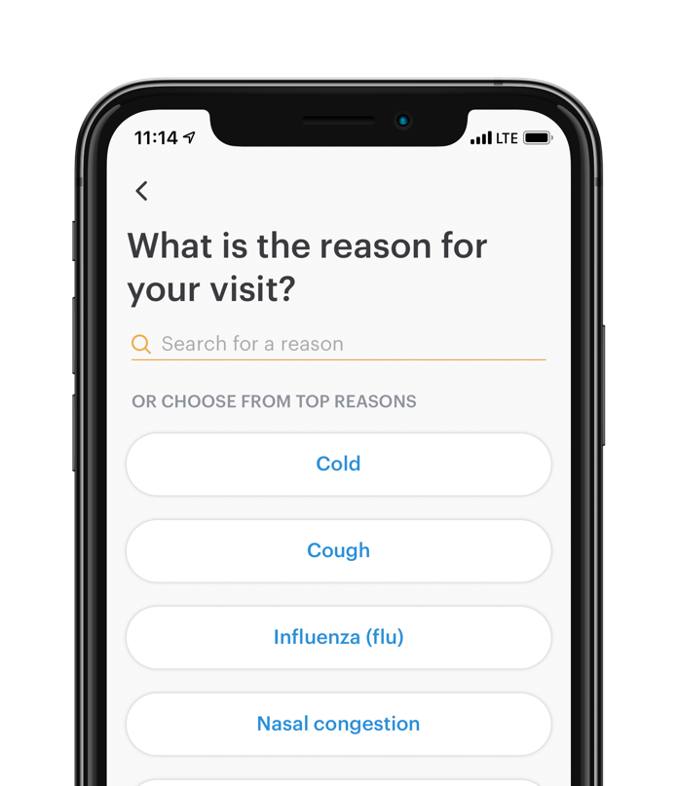
Skip the clinic trip
Save time and money by getting treated right from your smartphone, tablet or computer. Your plan has options.
Video chat
Convenient, quick and affordable.
Assessment, diagnosis and prescriptions when necessary.
15-minute visit to treat conditions like colds, the flu and allergies.
doctorondemand.com
Notes:
The second telemedicine service I want to talk about is Doctor on Demand. There are many similarities between doctor on demand and virtuwell but they do differ slightly.
So why would I recommend Doctor on Demand? Well there are a couple of reasons
Doctor On Demand (video chat)
Convenient. Get started when and where it works for you at doctorondemand.com. Doctor on demand has video capabilities so the device you are using should have video.
Quick. See a doctor in minutes. Live video visits include assessment, diagnosis and prescriptions when necessary.
Affordable. A visit to treat conditions like colds, the flu and allergies costs $59 or more depending on the service and amount of time needed for the visit*
*The cost for behavioral health services varies depending on the services provided and duration of service.

Slide 4
Thanks!
healthpartners.com
Notes:
To wrap up, I wanted to mention that There may be other telehealth options available to you through your local clinic due to Coronavirus and the shift in care it has brought. As a reminder, Sourcewell offers 1 free telehealth visit for the time period of 4/1/20-12/31/20 so if you feel that you need to see a doctor, you can always start with virtuwell or doctor on demand. If they cannot treat your needs, call your local clinic to see if they have telehealth services available.
Please call member services with any additional questions you may have regarding your benefits or questions about these services. Thanks for yoru time today.

